Slide 1
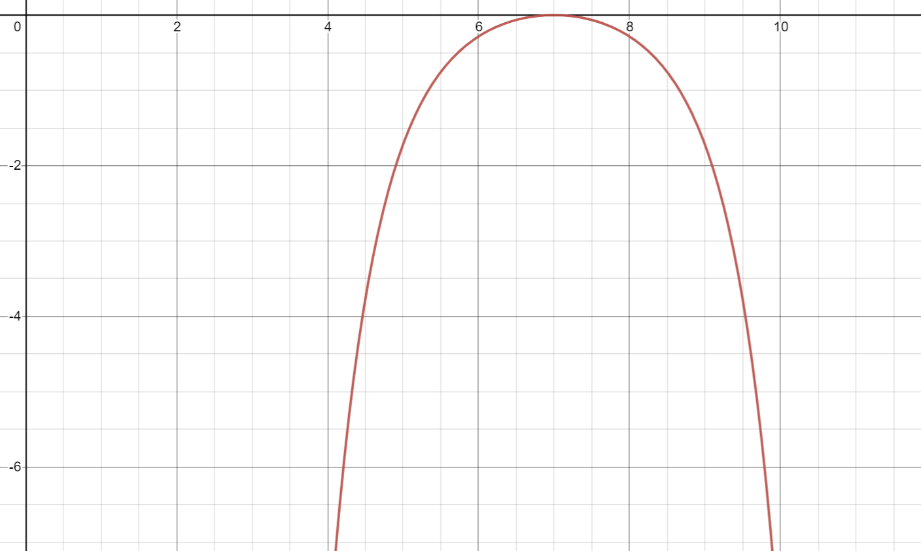
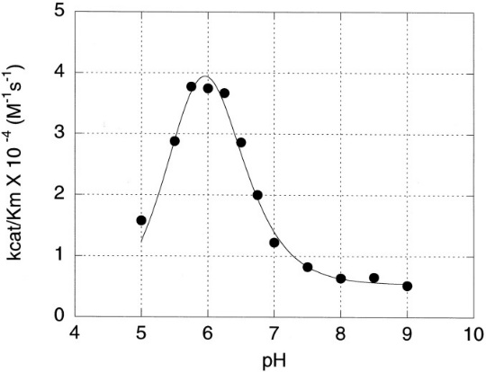
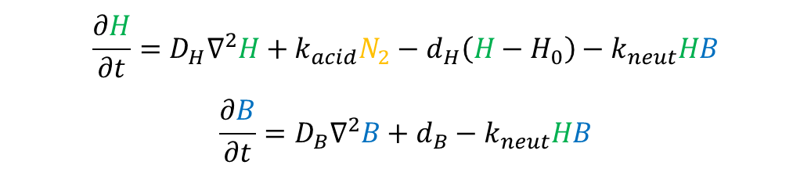



proliferation
carrying capacity is lowered by presents of matrix
diffusion
limited by presence of matrix
slower growth/death
from non-optimal pH
$$\frac{∂N_{1}}{∂t}=k_{1}N_{1}\left(1−\frac{N_{1}}{θ_{1}−α_{1}M}−\frac{N_{2}}{θ_{2}−α_{2}M}\right)+∇∙\left(D_{N_{1}}\left(1−\frac{N_{1}}{θ_{1}−α_{1}M}−\frac{N_{2}}{θ_{2}−α_{2}M}\right)∇N_{1}\right)−f_{1}\left(H\right)N_{1}$$
$$\frac{∂N_{2}}{∂t}=k_{2}N_{2}\left(1−\frac{N_{1}}{θ_{1}−α_{1}M}−\frac{N_{2}}{θ_{2}−α_{2}M}\right)+∇∙\left(D_{N_{2}}\left(1−\frac{N_{1}}{θ_{1}−α_{1}M}−\frac{N_{2}}{θ_{2}−α_{2}M}\right)∇N_{2}\right)−f_{2}\left(H\right)N_{2}$$
$$f_{1}\left(H\right)=d_{1}\left(1−e^{{\left(\frac{H−H_{1}^{opt}}{H_{1}^{width}}\right)}^{2}}\right)$$
$$f_{2}\left(H\right)=d_{2}\left(1−e^{{\left(\frac{H−H_{2}^{opt}}{H_{2}^{width}}\right)}^{2}}\right)$$
healthy cells
tumor cells
matrix degradation by MMPs
optimal pH curve
$$\frac{∂M}{∂t}=−f_{MMP}\left(H\right)PM$$
$$\frac{∂P}{∂t}=D_{P}∇^{2}P+{k_{P}N}_{2}−d_{p}P$$
generalized
extracellular matrix
MMP degradation
acid production
by tumor cells
hydrogen uptake
by surrounding tissue
MMPs
diffusion
$$\frac{∂H}{∂t}=D_{H}∇^{2}H+k_{acid}N_{2}−d_{H}\left(H−H_{0}\right)−k_{neut}HB$$
$$\frac{∂B}{∂t}=D_{B}∇^{2}B+d_{B}−k_{neut}HB$$
acid-base neutralization
diffusion
MMP production
by tumor cells
protons
bicarbonate
treatment
diffusion
acid-base neutralization
$$f_{MMP}\left(H\right)=$$
bicarbonate
introduction
pH-dependent MMP activity
Use initial conditions to introduce B into system instead

